Slide 1
Content Extraction: A Paper Presentation
Miranda Smith
CS 834
9/15/2017

Slide 2
Table of Contents
Content Extraction
DOM-based Content Extraction of HTML Documents (2003)
Suhit Gupta, Gail Kaiser, David Neistadt, Peter Grimm
Content Code Blurring: A New Approach to Content Extraction (2008)
Thomas Gottron

Slide 3
Content Extraction
Isolating the main content of a page
Uses
Mobile devices
Speech rendering
IR
Web mining
Notes:
Both of these papers are focused on the topic of Content Extraction.
CE is useful for displaying websites on mobile devices ( or any space constrained device), speech rendering for the visually impaired, Information Retrieval, and web mining

Slide 4
DOM-based Content Extraction of HTML Documents
Goal : Remove non-content
Create DOM tree from HTML
Filtering
Tag Ignoring
Advertisement Remover
Link List Remover
Empty Table Remover
Removed Link Retainer
Notes:
The strategy introduced by “DOM-based Content Extraction of HTML Documents” is as follows

Slide 5
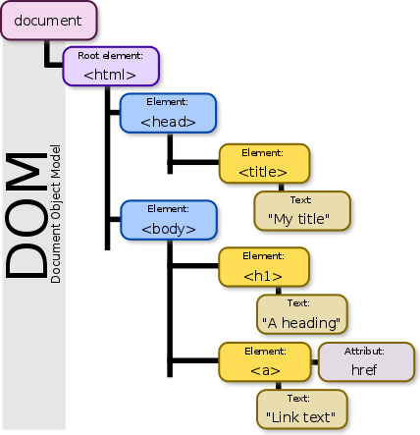
Create DOM tree from HTML
By Birger Eriksson - Own work, CC BY-SA 3.0, https://commons.wikimedia.org/w/index.php?curid=18034500
Notes:
openXML, HTML parser
It corrects the HTML so even badly created pages can be processed
The filtering techniques go through the DOM tree recursively

Slide 6
Filters
Tag Ignoring
Images
Links
Scripts
Styles
Advertisement Removal
‘src’ and ‘href’ tags
Black list
Link List Removal
Tables cells
Ratio Linked-Non Linked words
Empty Table Removal

Slide 7
Removed Link Retainer
Add Link Information
Retain Browsability

Slide 8
DOM based Approach
Pros
Cons
Highly customizable
Handle most web pages
Best on pages with large blocks of text
Worst case run time N²
Worst on pages with little or no textual information or mostly links
Scalability is limited due to proxy

Slide 9
Content Code Blurring: A New Approach to Content Extraction
Goal: Find main text through homogenously formatted sections
Create Content Code Vector
Find Content Code Ratio for each element
Create Regions based on CCR
Keep only regions with high ratio
Notes:
The strategy introduced by “DOM-based Content Extraction of HTML Documents” is as follows

Slide 10
Create Content Code Vector ( CCV )
Content vs Code
“Vector of Code Elements”
Token based
Character based
Adapted Character based
Ignores anchor tags
<b> This text is bold </b>
0 1 1 1 1 0
0 0 0 1 1 1 1 1 1 1 1 1 1 1 1 1 1 0 0 0 0

Slide 11
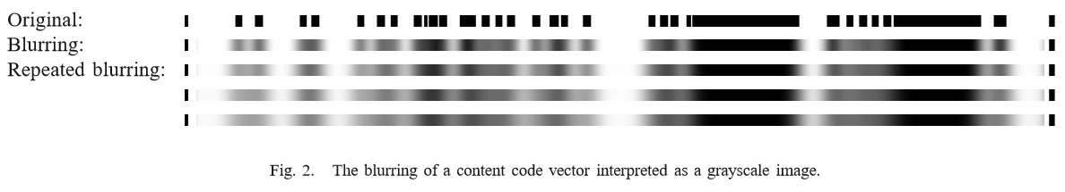
Content Code Ratio
Ratio of content vs code for its neighborhood
Calculate ratio for every element in CCV
Iteratively
Select elements as main content based off a threshold
Gottron (2008)

Slide 12
Content Code Blurring Approach
Pros
Cons
ACCB Performed consistently better than DSC
DSC = Document Slope Curves
Best technique of a previous comparison paper
TCCB comparably fast
ACCB and CCB reasonably fast
Does not work well for wiki documents
Ignores highly formatted main content
Headlines

Slide 13
Content Code Blurring vs DOM Based Approach
Solutions for Content Extraction
Content Code Blurring performs better and faster than the DOM based approach

Slide 14
References
Gupta, S., Kaiser, G., Neistadt, D., & Grimm, P. (2003, May). DOM-based content extraction of HTML documents. In Proceedings of the 12th international conference on World Wide Web (pp. 207-214). ACM.
Gottron, T. (2008, September). Content code blurring: A new approach to content extraction. In Database and Expert Systems Application, 2008. DEXA'08. 19th International Workshop on (pp. 29-33). IEEE.

